Slide 1

DISCLAIMER
50
We are not an Attorney or CPA, this presentation is based upon our experience
Some items discussed in this presentation may be different for you based on your specific situation, the state you live, and the current laws and regulation
Please consult your own legal counsel and CPA for your individual situation
It is not guaranteed the same exact legal language used in this presentation to explain concepts will be used in our contracts and agreements when we purchase the real estate property. Contracts and agreements are negotiated among different parties, and some language may need to be amended or modified in order to make a deal. Each deal is unique and different that may require modifications or additions to clauses in our contracts and agreements.
This presentation is not an offer; offers will be made only by means of Regulation A. The material and examples used in this presentation is for educational purposes and understanding of the concepts

Slide 2
MULTI-FAMILY REAL ESTATE PROPERTY CLASS
50
Class A: New to 10 years old. Market Cap rate 4 - 6%. High end interior and exterior amenities. High quality construction with high quality materials. Very little to no maintenance issues. Low vacancy and demand the highest rents. Attracts high-income earning tenants; these tenants usually take care of the property.
Class B: 10 to 20 years old. Market Cap rate 6 - 8%. Exterior and interior amenity package is dated and less than what is offered by properties in the high end of the market. Good quality construction. Some to little deferred maintenance. Rental income a bit lower than Class A. Attracts some middle-middle to mainly upper-middle income earning tenants.
Class C: 20 to 40 years old. Market Cap rate 6 - 8%. Limited, dated exterior and interior amenity package. Improvements show some age and deferred maintenance (this may require some costly maintenance). Majority of the appliances are original. Rental income below Class B. Attracts some lower-middle to mainly middle-middle income earning tenants
Class D: 40+ years old. Market Cap rate 8%+. Challenging to collect rent and the crime rate is generally high. Low construction quality and condition. Attracts lowest-income earning tenants; these tenants usually do not take care of the property. Rental income is in the lower side of the market. Nickname as the “war zone”.
References: https://retipster.com/class-a-b-c-d-properties-explained/

Slide 3
ITEMS TO KEEP IN MIND
50
The cap rates mentioned in previous slide can vary depending of the situation; for example, let’s say we have a Class C with a lot of value-add of 70% occupied and 30% units vacant (somewhat stable property). Due to this situation this property can be selling at higher cap rates
However, this particular property requires more capital, work and time; before it can optimally be rented at let’s say 90% - 95% occupied. At the same after fully stabilized, this particular property can generate great returns
The cap rate, when calculated correctly taking into account all operating expenses, gives you a picture of the current return the property is making. Basically, the current situation of the property’s financial
However, hidden items such as costly deferred maintenance inherited by new owners will decrease the cap rate in the future. This is because hidden items will be an expense to the new owner decreasing NOI and cap rate
A Buyer should be careful of the hidden items not taken into account in calculating the current cap rate for the property the Buyer wants to acquire

Slide 4
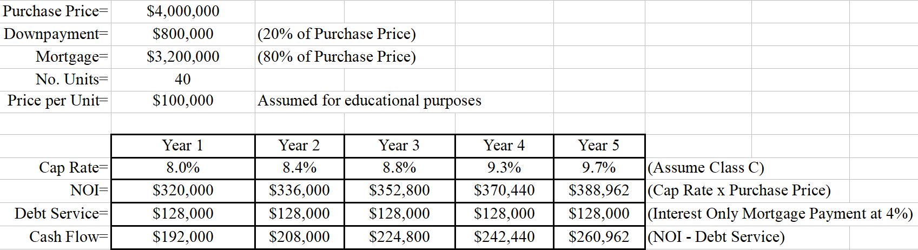
EXAMPLE 1 (CASH FLOW)
50
Assume Class C property with acquisition cap rate of 8.0%
Assume cap rate increased by 5% yearly; this is not guaranteed
Assume no refinance of the property, therefore, no increase in Debt Service

Slide 5
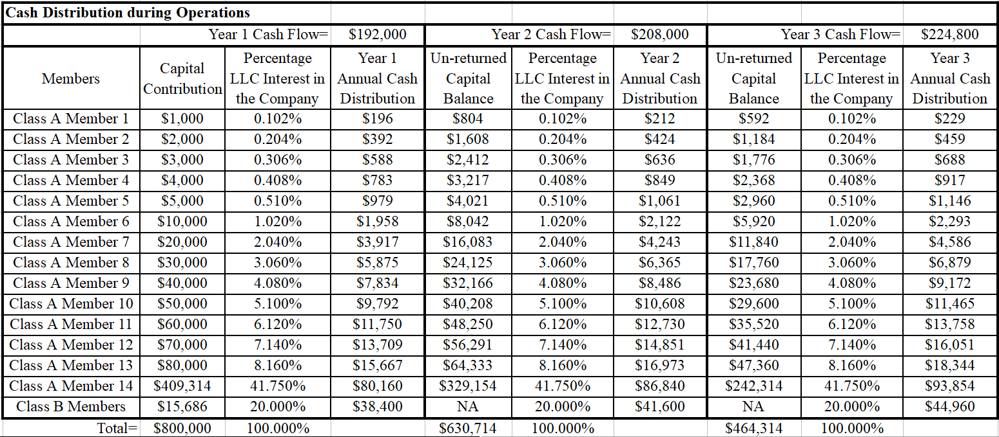
EXAMPLE 1 (CASH FLOW) - CONTINUED
50

Slide 6
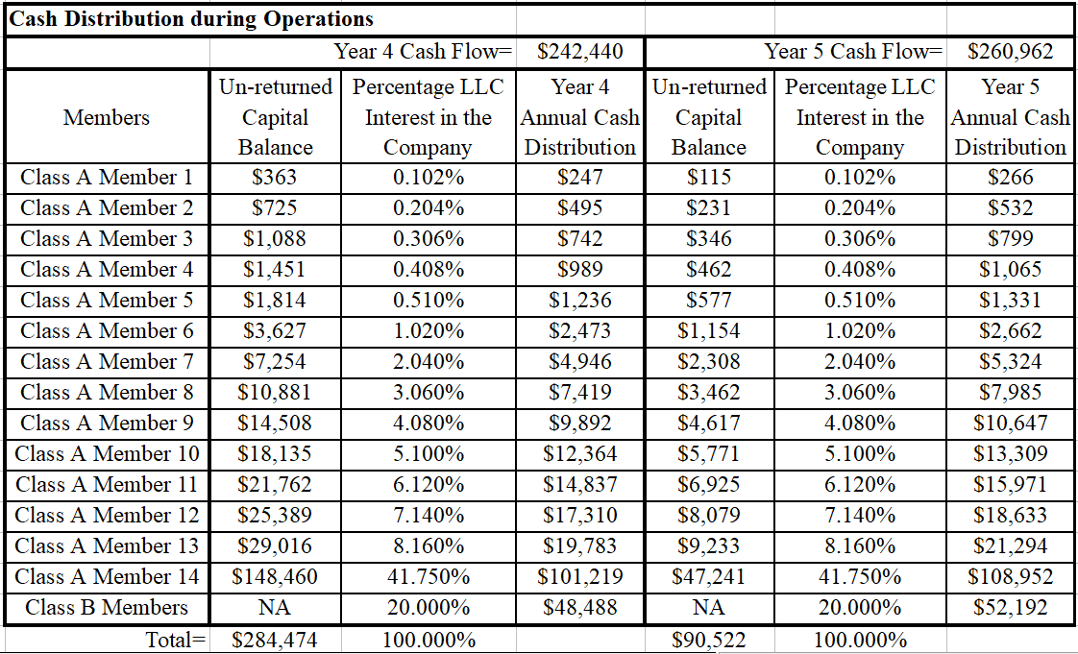
EXAMPLE 1 (CASH FLOW) - CONTINUED
50

Slide 7
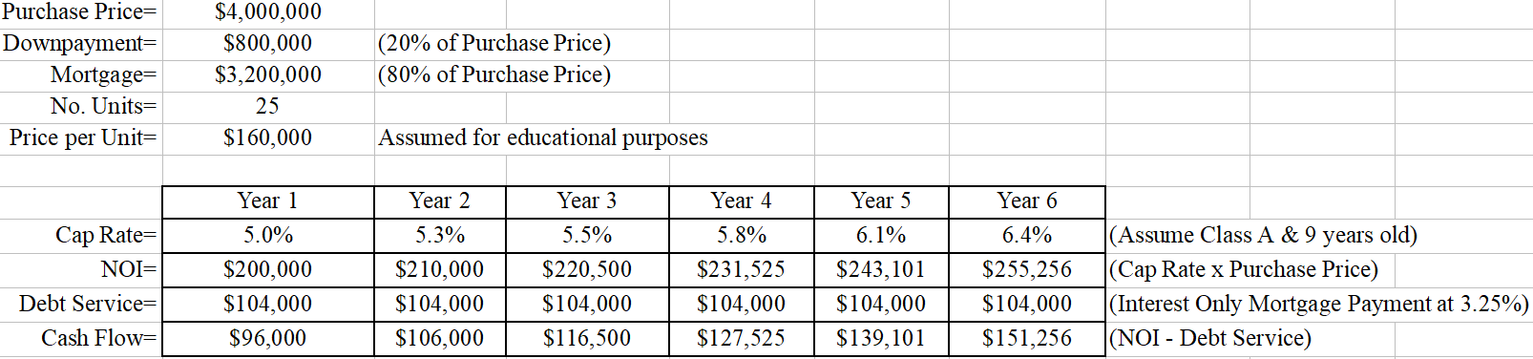
EXAMPLE 2 (CASH FLOW)
50
Assume Class A property with acquisition cap rate of 5.0%
Assume cap rate increased by 5% yearly; this is not guaranteed
Assume no refinance of the property, therefore, no increase in Debt Service

Slide 8
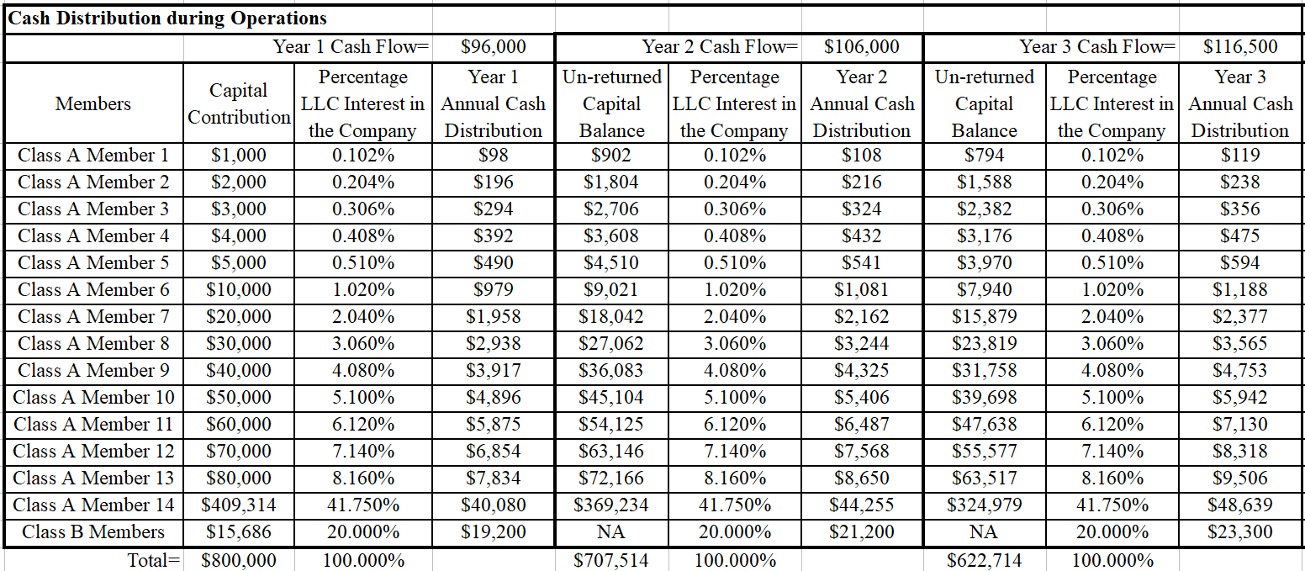
EXAMPLE 2 (CASH FLOW) - CONTINUED
50

Slide 9
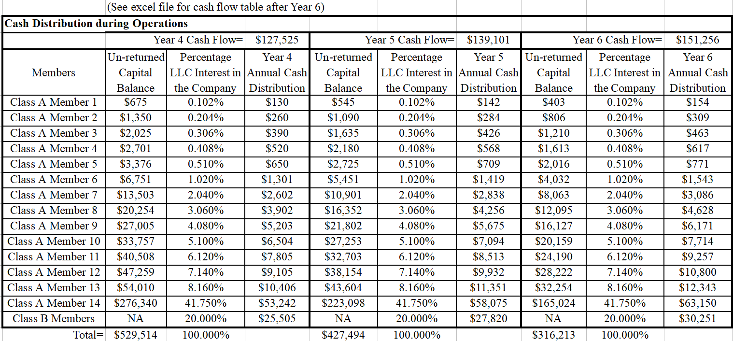
EXAMPLE 2 (CASH FLOW) - CONTINUED
50

Slide 10
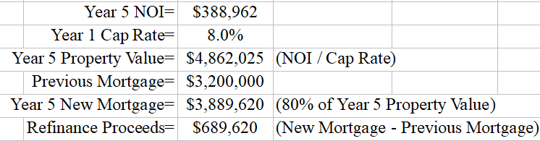
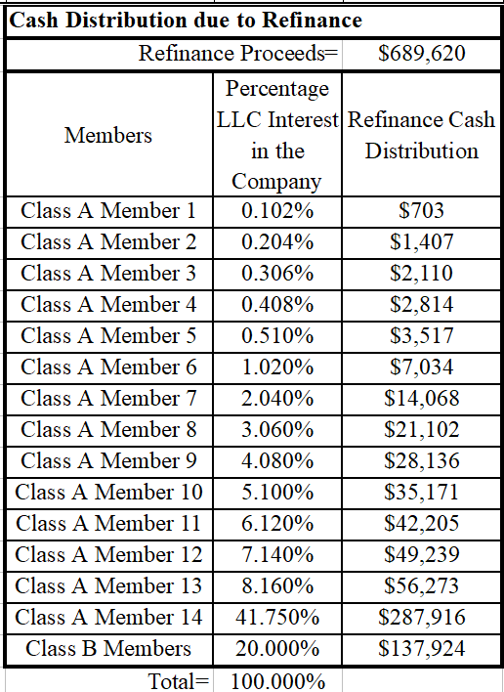
EXAMPLE 1 (REFINANCE)
50
At end of Year 5, we can refinance using the Year 5 NOI and Year 1 Cap Rate to calculate the Year 5 Property Value
The lender usually allows for 80% Loan-to-Value (LTV), which will become Year 5 New Mortgage
The Previous Mortgage is paid and the difference between New and Previous Mortgage is the cash-out from refinance
Although Debt Service may increase due to refinance, the NOI has increased as well to afford the New Debt Service
Refinance Proceeds are tax-free because is additional debt taken by the LLC. Refinance Proceeds are additional Cash Distribution on top of yearly cash flow from the property shown in previous slides

Slide 11
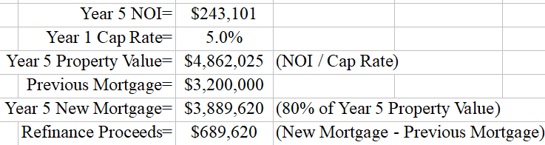

EXAMPLE 2 (REFINANCE)
50
At end of Year 5, we can refinance using the Year 5 NOI and Year 1 Cap Rate to calculate the Year 5 Property Value
The lender usually allows for 80% Loan-to-Value (LTV), which will become Year 5 New Mortgage
The Previous Mortgage is paid and the difference between New and Previous Mortgage is the cash-out from refinance
Although Debt Service may increase due to refinance, the NOI has increased as well to afford the New Debt Service
Refinance Proceeds are tax-free because is additional debt taken by the LLC. Refinance Proceeds are additional Cash Distribution on top of yearly cash flow from the property shown in previous slides

Slide 12
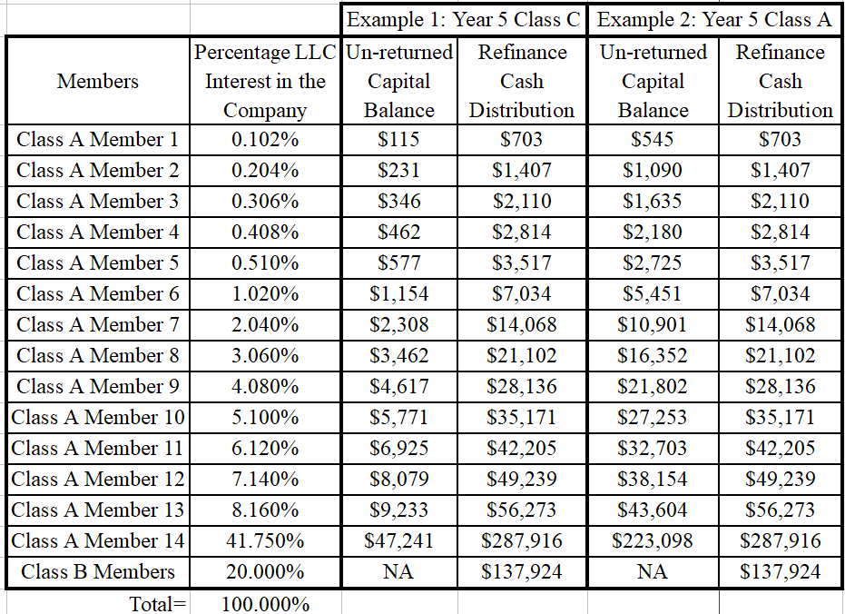
CONCLUSION
50
Although Class C property provide better Cash Flow with more risks than Class A or Class B. The numbers show that Class A or Class B catch up with Class C returning all capital back to investors about the same time
If we can all take a lower cash flow with Class A or Class B and wait until refinance. We are able to buy the most desirable properties with more stability and set ourselves for a stable future

Slide 13
DISCLOSURES-1
50
These disclosures are applicable to all the examples shown in this presentation:
There is an assumed price per unit; the price per unit can vary for the Class multi-family property in question due to many factors such as location, current property’s financial and physical condition, etc
The above examples are estimates of the type of returns this property can provide to investors
Assume Class B member’s capital contribution is 2.0% of the total Class A member’s capital contribution
CASH FLOW: Assume Class B member’s receive 20% of the Distributable Cash and Class A members receive 80% of the Distributable Cash. This condition can change depending on the Operating Agreement terms signed between Class B and Class A members
REFINANCE: Assume Class B member’s receive 20% of the Distributable Cash and Class A members receive 80% of the Distributable Cash. This condition can change depending on the Operating Agreement terms signed between Class B and Class A members
It is not guaranteed that we can refinance the property by Year 5 as shown in these examples, could take longer depending on market conditions and other factors
For simplicity, the Percentage LLC Interest matches the percentage of how Distributable Cash is distributed among Class B and Class A members
The examples do not take into account possible Capital Expenditures which will affect Cash Flow

Slide 14
DISCLOSURES-2
50
Asset management fees are not included in the examples
Year 1 does not begin at the date of the property purchase. Year 1 begins after the 3 - 6 months period used to build cash reserves for the property
Assumed mortgage terms/payments may change throughout the life of the loan. We will evaluate the mortgage rates constantly to take advantage of better mortgage terms to decrease Debt Service
Above financial projections are not guarantees of future performance and involve known and unknown factors, risks, uncertainties and contingencies, many of which are beyond management’s control. These factors and risks could cause actual results and performance to differ materially from the above financial projections.

