Slide 1

DISCLAIMER
50
We are not an Attorney or CPA, this presentation is based upon our experience
Some items discussed in this presentation may be different for you based on your specific situation, the state you live, and the current laws and regulation
Please consult your own legal counsel and CPA for your individual situation
It is not guaranteed the same exact legal language used in this presentation to explain concepts will be used in our contracts and agreements when we purchase the real estate property. Contracts and agreements are negotiated among different parties, and some language may need to be amended or modified in order to make a deal. Each deal is unique and different that may require modifications or additions to clauses in our contracts and agreements.
This presentation is not an offer; offers will be made only by means of Regulation A. The material and examples used in this presentation is for educational purposes and understanding of the concepts

Slide 2
TOOLS/ITEMS NEEDED TO BUY A REAL ESTATE PROPERTY
50
Down payment (Regulation A)
Third-Party Property Management Company
Limited Liability Company
(LLC) (the “Company”)
Property Management Agreement
Due Diligence Items: Property inspection, title search, survey, reports, etc
Mortgage
(Lender)
Purchase and Sales Contract
Buyer, Buyer’s Real Estate Attorney
Seller, Seller’s Attorney, Seller’s related items

Slide 3
LIMITED LIABILITY COMPANY-1
50
As explained before, it is a business structure that protects its owners from personal responsibility for LLC's debts or liabilities. An LLC is a formal partnership arrangement that requires articles of organization to be filed with the state.
LLC separates the business assets of the company from the personal assets of the members, insulating the members from the LLC’s debts and liabilities
Flow-through taxation to the members (LLC treated as partnership); therefore, the LLC does not pay taxes on the profits directly. Profits and Losses are passed through to members, who report them on their individual tax returns. This avoids double taxation of both the company and its individual members
LLC has to file IRS form 1065 (LLC treated as partnership) and provide schedule K-1 to the members who use it to file their individual tax returns
https://www.investopedia.com/terms/l/llc.asp#citation-15
https://www.irs.gov/pub/irs-pdf/p3402.pdf

Slide 4
LIMITED LIABILITY COMPANY-2
50
In Illinois, an LLC can be organized as following (similar steps in other states):
Choose a registered agent such as https://www.illinoisregisteredagent.net/. The registered agent receives service of process notices, government correspondence and compliance-related documents on behalf of the LLC
File the Articles of Organization with the Secretary of the Illinois State using form LLC-5.5 https://www.ilsos.gov/publications/pdf_publications/llc55.pdf
Some states require Operating Agreements and others do not. Note that US GROUP HOLDINGS LLC will have an Operating Agreement as well as other documents required per Regulation A
Obtain an EIN from the IRS (Employer Identification Number) at https://www.irs.gov/businesses/small-businesses-self-employed/apply-for-an-employer-identification-number-ein-online. The EIN is used to open LLC’s bank accounts, file tax forms, etc.
After filing Articles of Organization, anyone can do a search of the legality of the LLC in Illinois at: https://ilsos.gov/departments/business_services/corp.html

Slide 5
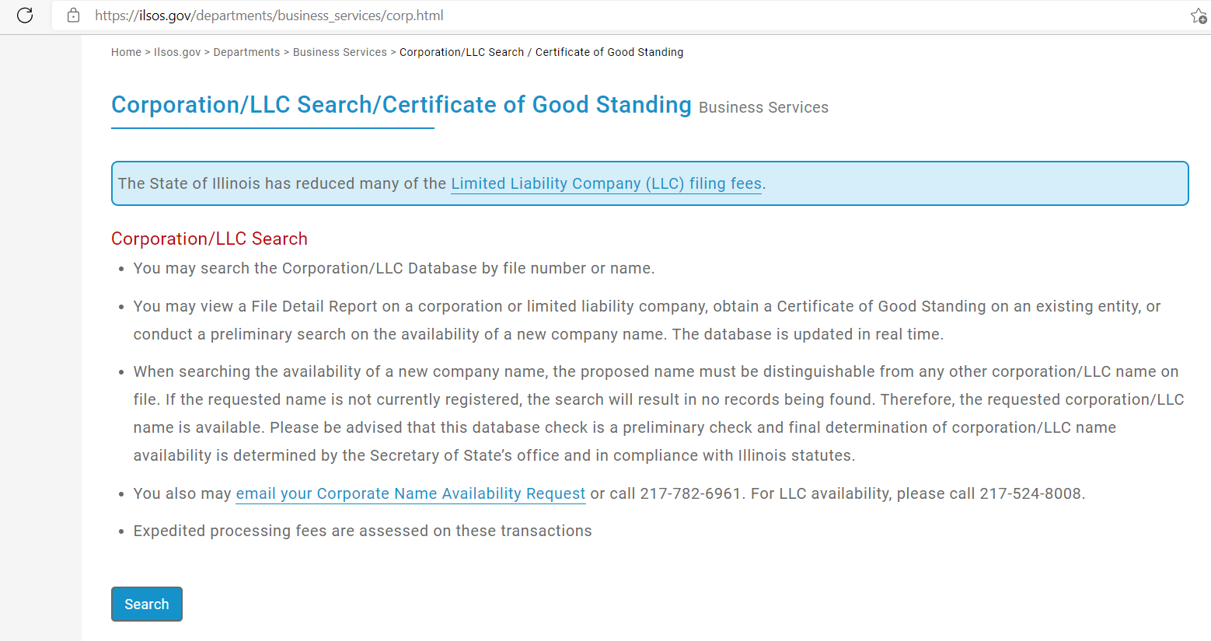
LIMITED LIABILITY COMPANY-3
50
US GROUP HOLDINGS LLC can be search as following:

Slide 6

LIMITED LIABILITY COMPANY-4
50

Slide 7
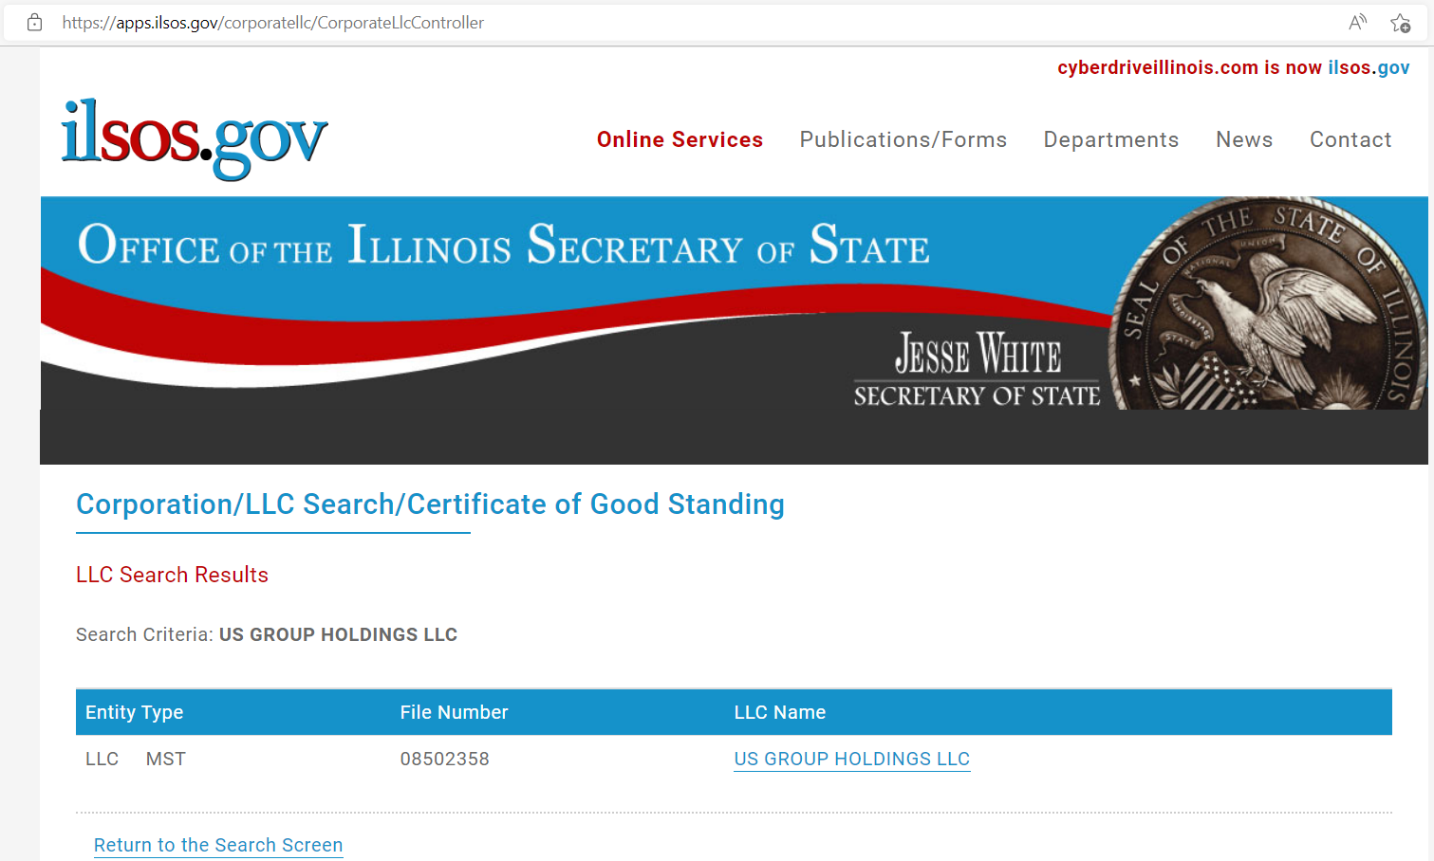
LIMITED LIABILITY COMPANY-5
50

Slide 8
FORM 1065 - 1
50
Form 1065 is an information return used to report income, gains, losses, deductions, credits and other information from the operation of the LLC treated as a partnership. Generally, a LLC treated as a partnership does not pay tax on its income but passes through any profits or losses to its members
We will use a real world example with numbers to show the concepts of Form 1065 for an LLC that owns a multi-family real estate property
Due to confidentiality, only the profit and loss statements pages will be shown, other sensitive information such as property address, party who prepared profit and loss statements, etc will not be shown to the general public. If you would like to verify the information further of this real world example please contact us
The real world example does not necessarily represent the type of property we will pursue for our acquisitions
https://www.irs.gov/pub/irs-pdf/f1065.pdf
https://www.irs.gov/pub/irs-pdf/i1065.pdf

Slide 9
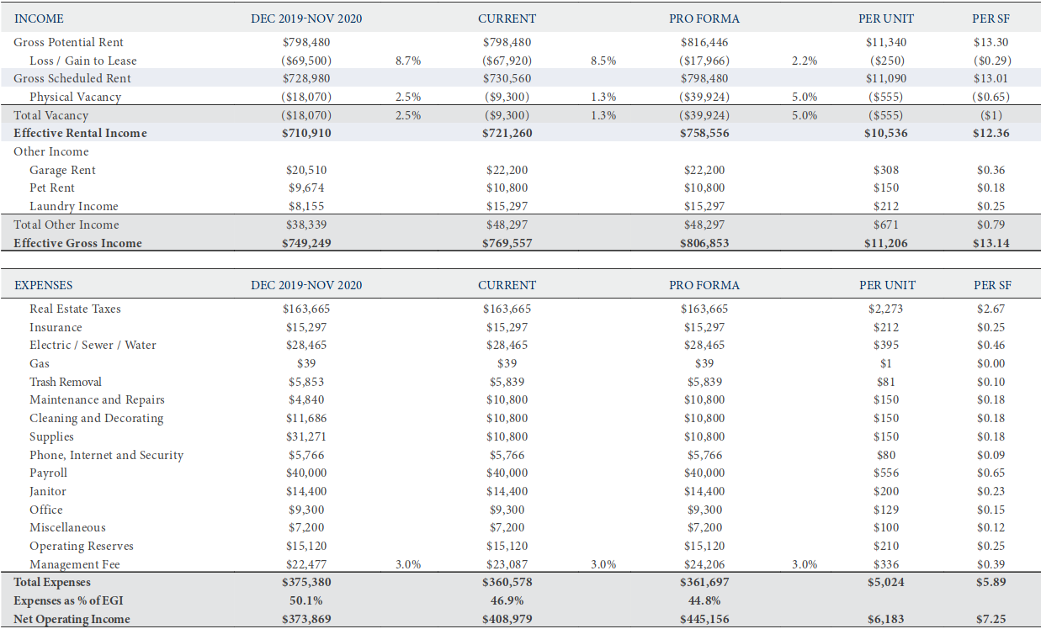
FORM 1065 - 2
50
Profit and Loss Statements from third party

Slide 10
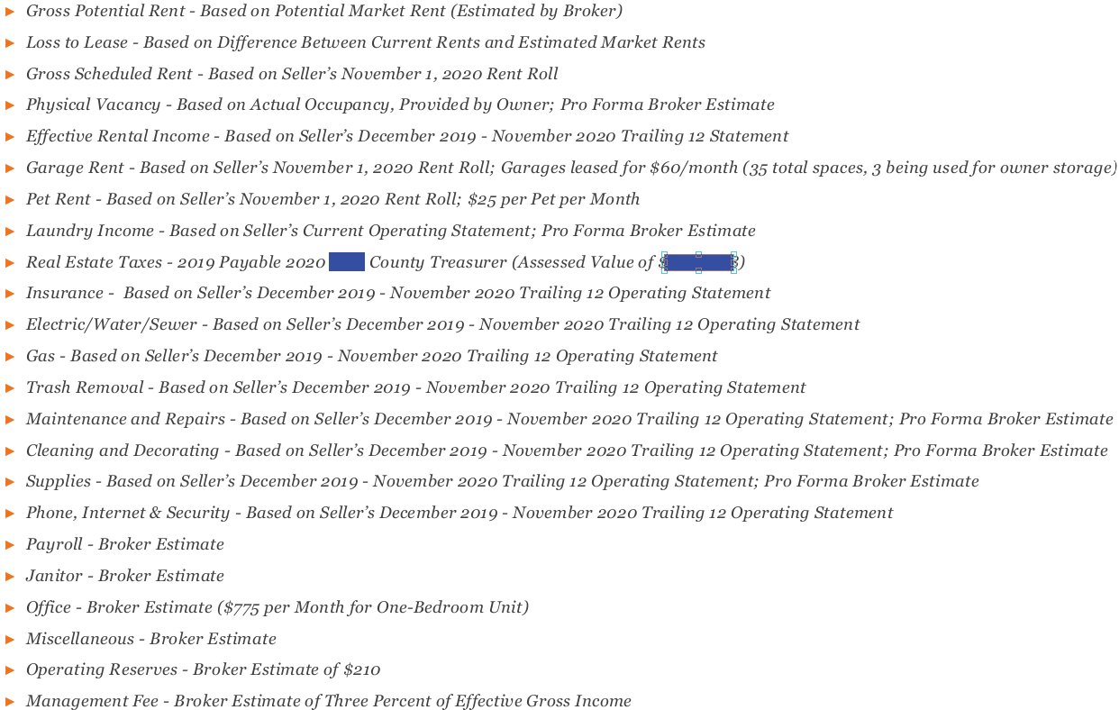
FORM 1065 - 3
50
Notes to Profit and Loss Statements

Slide 11
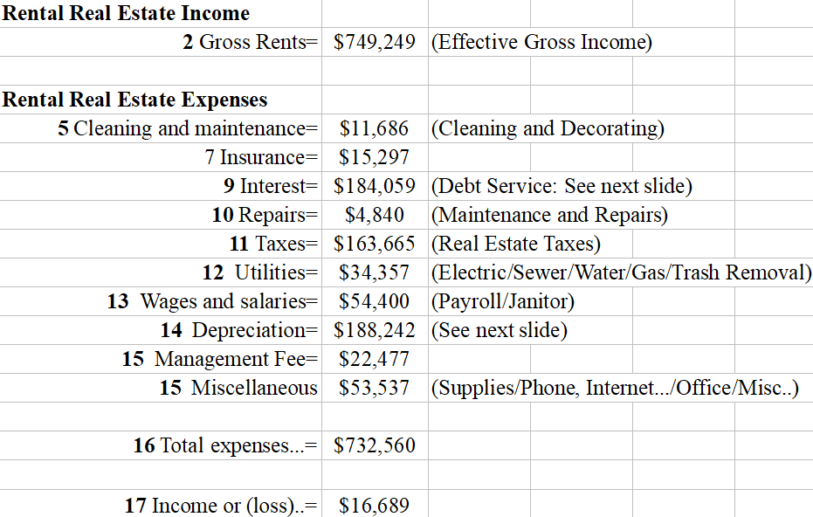
FORM 1065 - 4
50
See the annual summary of the numbers from the real world example for DEC 2019 - NOV 2020 compiled to file Form 1065
Operating Reserves $15,120 is excluded from the “Real Estate Expenses” in Form 8825 because this money is saved as reserves and not spend on operations

Slide 12
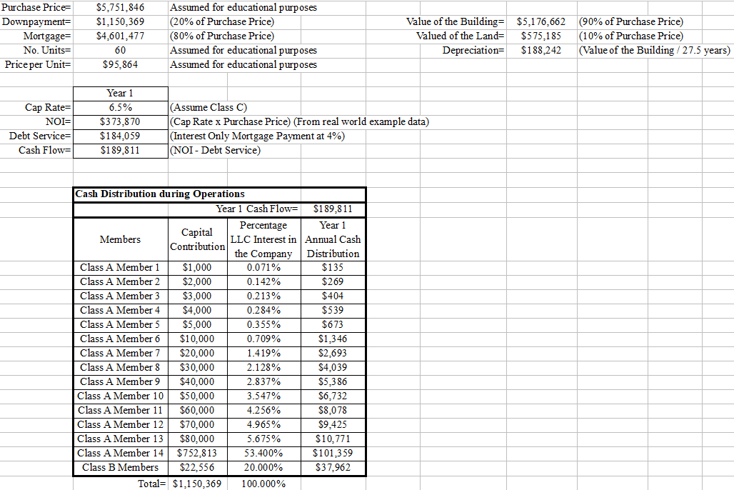
FORM 1065 - 5
50
Tax law allows multi-family property to be depreciated over 27.5 years
Assume Value of the Building is 90% of the Value of Building + Land together. The County where the property is located can provide accurate percentages but 90% is not a bad assumption. Land is not depreciable
Assume acquisition Cap Rate = 6.5%

Slide 13
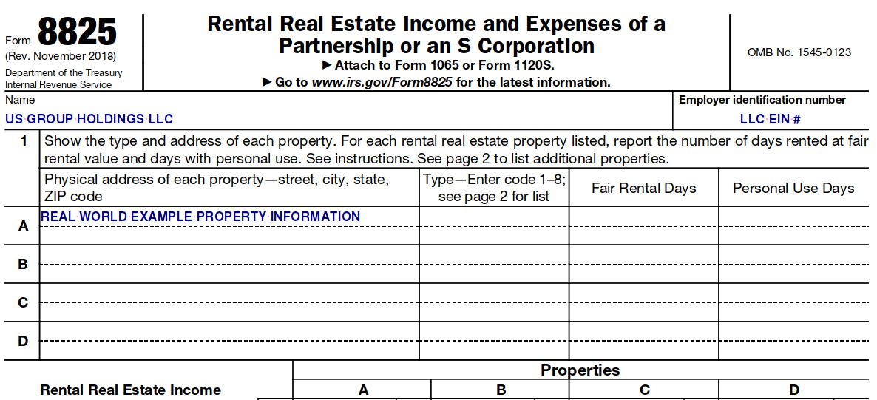
FORM 1065 - 6
50
As part of Form 1065, the LLC needs to file Form 8825 as shown below

Slide 14
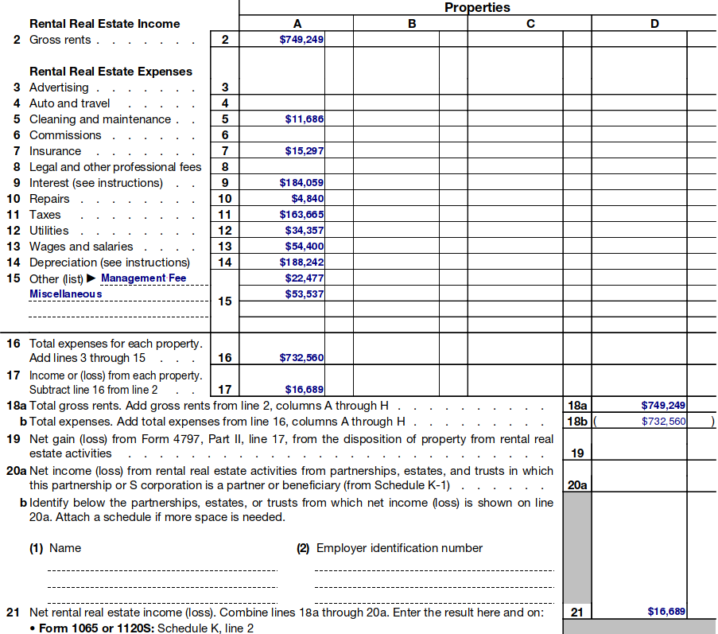
FORM 1065 - 7
50
This slide is the continuation of Form 8825 from previous slide
The value of $16,689 in Line 21 of Form 8825 will be used in Form 1065: Schedule K, line 2
https://www.irs.gov/pub/irs-pdf/f8825.pdf

Slide 15
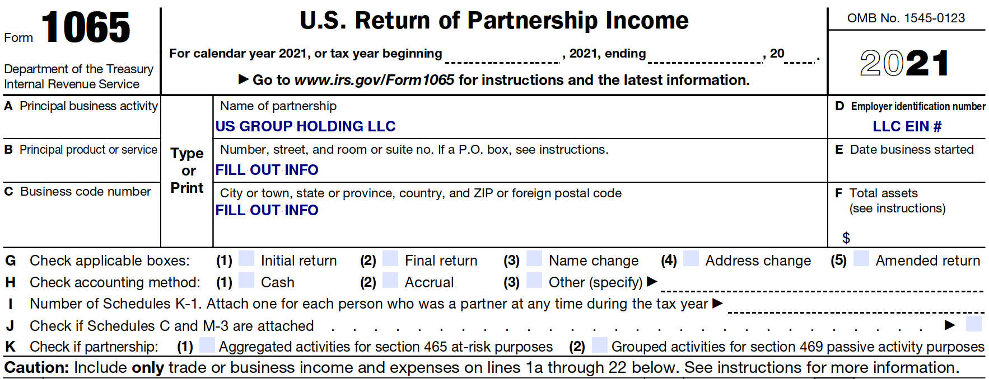
FORM 1065 - 8
50
Below are incomplete sections of Form 1065 for educational purposes to show how the information flow as following: Form 8825 ---> Form 1065 ---> Schedule K-1

Slide 16
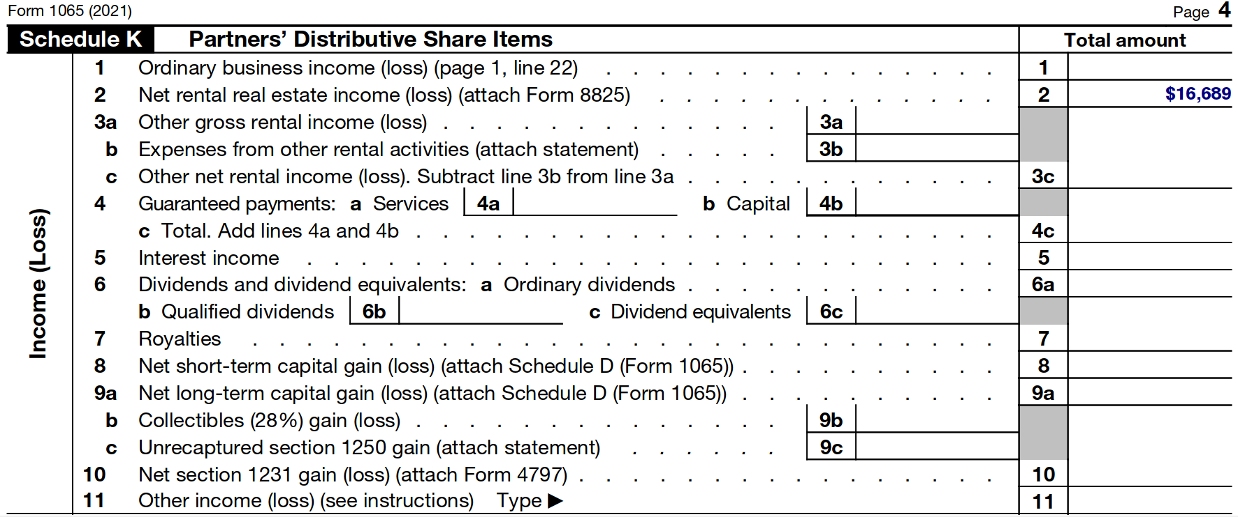
FORM 1065 - 9
50
The value of $16,689 in Line 21 of Form 8825 will be used in Form 1065: Schedule K, line 2

Slide 17
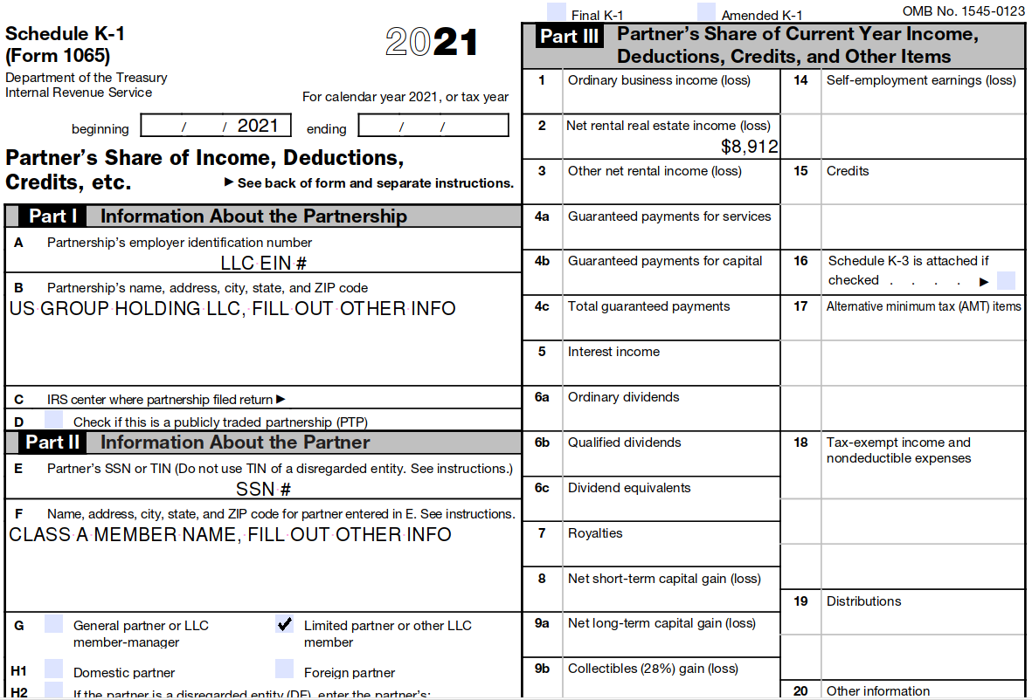
SCHEDULE K-1 - 1
50
Let’s take for example “Class A Member 14” with “Capital Contribution = $752,813”. “Percentage LLC Interest in the Company = 53.400%”. “Current year net income (loss) = $16,689 x (53.400% / 100%) =$8,912”. “Cash Distribution = $101,359”
Schedule K-1 is used by the LLC member to file his/her/its individual income tax return
The schedule K-1 of Class A Member 14 may look similar to:

Slide 18
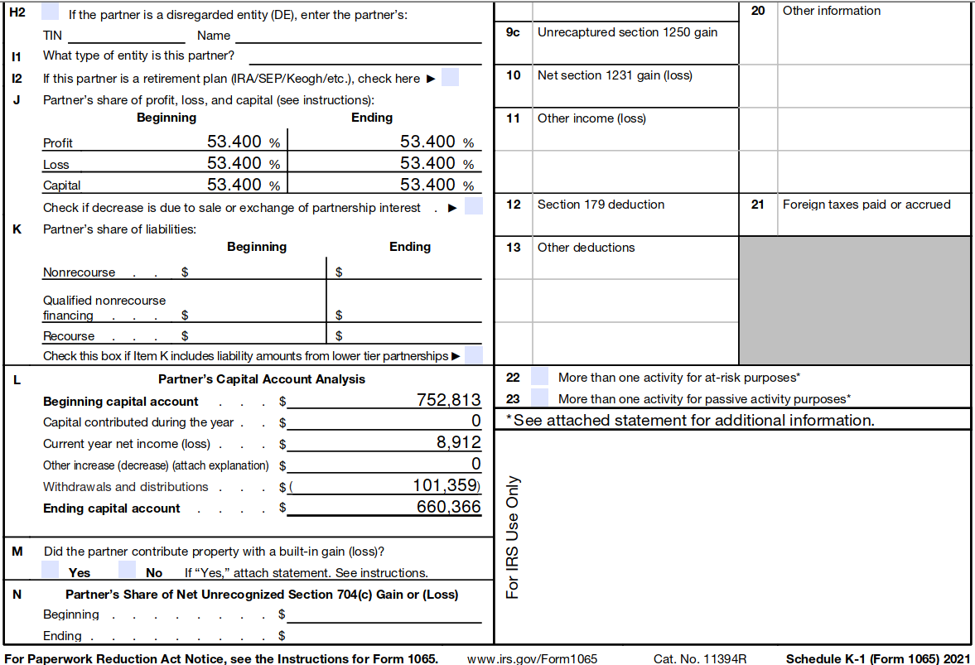
SCHEDULE K-1 - 2
50
https://www.irs.gov/pub/irs-pdf/f1065sk1.pdf
https://www.irs.gov/pub/irs-pdf/i1065sk1.pdf

