Slide 1

DISCLAIMER
50
We are not an Attorney or CPA, this presentation is based upon our experience
Some items discussed in this presentation may be different for you based on your specific situation, the state you live, and the current laws and regulation
Please consult your own legal counsel and CPA for your individual situation
It is not guaranteed the same exact legal language used in this presentation to explain concepts will be used in our contracts and agreements when we purchase the real estate property. Contracts and agreements are negotiated among different parties, and some language may need to be amended or modified in order to make a deal. Each deal is unique and different that may require modifications or additions to clauses in our contracts and agreements.
This presentation is not an offer; offers will be made only by means of Regulation A. The material and examples used in this presentation is for educational purposes and understanding of the concepts

Slide 2
SOME TYPES OF INCOME
50
Earned Income: Earned money through a paycheck which is exchanging time for money. For example, when you work as an “employee” as a web designer, a grocery store cashier, a police officer, etc, you are getting paid a predetermined amount of money (X) to do that job for a certain amount of time (Y). Disadvantages: If you want more money, you need to work more hours, because you are exchanging time; this time can be used to spend with family, friends, health (i.e. exercise), better yourself, do things you love. This income is taxed the highest
Portfolio Income: It is “interest earned” by owning U.S. government bonds, other type of bonds, bank savings, checking account, money market or certificate of deposit. Also, it is “dividend earned” from owning dividend stocks in the stock market. Also, it is “capital gains” paid out for investments, like stocks and funds, that gain in value when you sell those investments. Disadvantages: Hard to time the market for “capital gains”. Annual “Dividend earned” is small of a percentage for good stable companies stocks. This income is taxed at large percentage rates
Passive Income: It is income that may require an initial investment of time and money for its creation / real estate property acquisition. After the initial phase, it requires minimal labor to earn and maintain. For example, once you have a property, it provides cash flow whether you are working or not. Money keeps coming into your pocket and you are free to do other things. There are ways to reduce taxes to zero legally with this income. Disadvantages: It requires high financial IQ and patience to invest successfully for passive income.
https://www.richdad.com/3-types-of-income

Slide 3
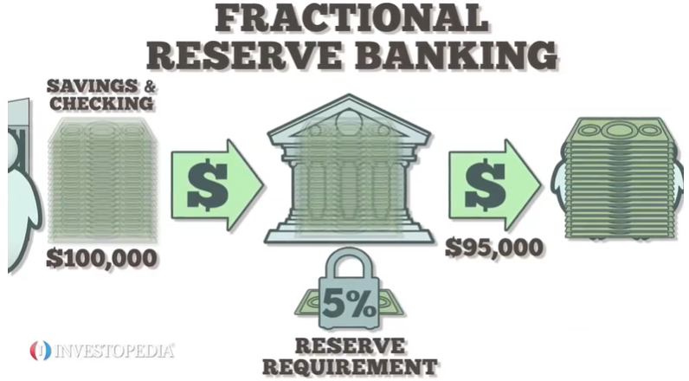
HOW DOES THE BANK USE OUR MONEY?-1
50
Fractional Reserve Banking: Per law, it requires banks to hold only a fractional amount of the money their customers deposit. In the United States, the reserve requirement percentage is set by the Federal Reserve (central bank). Depending on current policies this percentage varies, and it could be 5% - 10% of the customers deposit; and as shown in the reference in the next slide, on March 15, 2020 the Federal Reserve reduce the reserve requirement to 0%. The fractional reserve system purpose is to expand the economy as follow:
Let’s say the reserve requirement is 5% and customers deposit a total of $100,000 in bank A. Then, bank A can loan $95,000 to people or companies to buy homes, cars, fund businesses, fund other projects, buy real estate property. In essence bank A has created $195,000 out of thin air
If the $95,000 loan is deposited into bank B, then Bank B can loan $90,250 to other people and the process keep repeating itself
Banks loan our money at some interest, and we do not receive any interest on this money that banks use on our behalf when we keep money in our bank accounts

Slide 4
HOW DOES THE BANK USE OUR MONEY?-2
50
References:
https://www.investopedia.com/terms/f/fractionalreservebanking.asp
https://www.thebalance.com/what-is-fractional-reserve-banking-4590236#citation-1
https://www.federalreserve.gov/monetarypolicy/reservereq.htm

Slide 5
ASSETS VS LIABILITIES
50
The wealthy buy assets which produce “income”; and use this “income” to buy liabilities
The bank uses our money to acquire assets. For example, the bank lends money to the Buyer to buy a real estate property using a Mortgage agreement. The Mortgage agreement gives the bank ownership rights and ability to foreclosure on the property if needed (Realistically, the bank has the larger percentage ownership in the property)
Assets: Simply an asset cash flow money into your pocket. This is to say, anything that puts money in your pocket regardless of whether or not you work
Liabilities: Simply a liability cash flow money out of your pocket. This is to say, anything that takes money out of your pocket.
If you own a house and you live in it, then it is a liability because it takes money out of your pocket via mortgage, insurance, property taxes, maintenance, etc payments you have to make
If you own the same house and rent it to someone else, then it is an asset because it puts money in your pocket via rental income
https://www.richdad.com/assets-and-liabilities#:~:text=Rich%20dad%20describes%20an%20asset%20as%20anything%20that,wanted.%20Boats%20are%20notorious%20for%20being%20money%20pits.

Slide 6
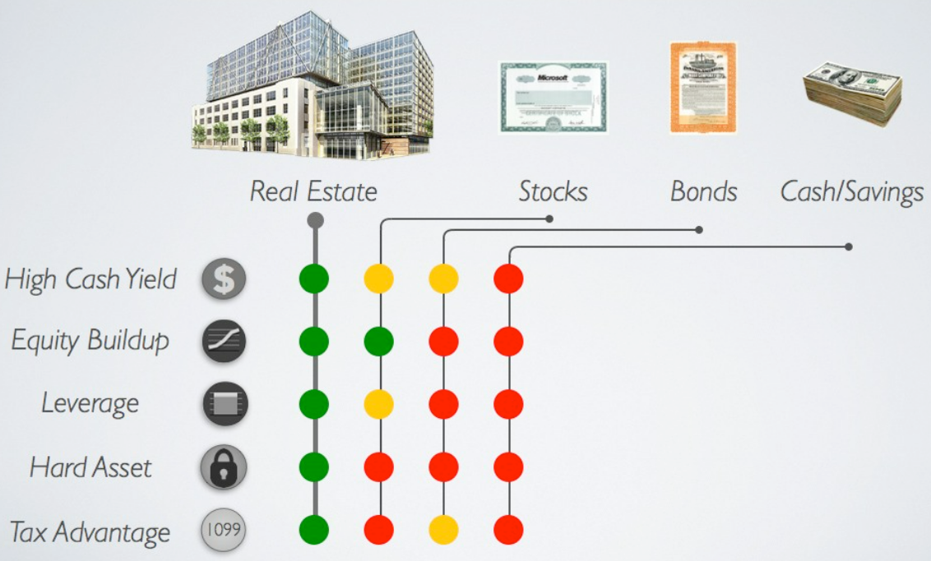
REAL ESTATE, STOCKS, BONDS, CASH - 1
50
Red color means you can’t take advantage at all of the 5 items / benefits shown on the left side of the picture
Yellow means you can take some/few advantages
Green means you can take full advantage of the 5 items / benefits of the investment

Slide 7
REAL ESTATE, STOCKS, BONDS, CASH - 2
50
High Cash Yield: Real estate properties are generally secured by leases which provide a regular income stream, significantly higher than typical stock dividend yields.
Equity Buildup: Historically provides excellent appreciation in value that meet and exceed other investment types. Properties can go up in value from internal factors such as proactive management, making cost-effective improvements to the property that improve its usability and desirability; and external factors such as supply and demand
Leverage: The ability to place debt on the property which is several times the original equity. This allows you to buy more properties with less money and significantly magnify your equity as the loans are paid down.
Hard Asset: One of the few investment classes that is a hard asset that has meaningful intrinsic value. The property’s land has value, as does the structure itself. By choosing the location and property quality wisely, investors can benefit from the security of knowing that they own a property that has potential to earn income regardless of what happens to the existing tenant(s). This is the reason real estate property investments do not fluctuate with the same volatility as the stock market.
Tax Advantage: The US Tax code benefits real estate owners in a number of ways. Mortgage interest and depreciation deductions can shield a large portion of your income stream.

